Slide 1
Scanning the environmental factors using PESTLE analysis, BCG matrix and GE matrix.
MODULE – 9

Slide 2
Course Outcomes
Course Outcome | Description | Bloom’s Taxonomy Level
PO2/PEO3 | Scanning the environmental factors using PESTLE analysis, BCG matrix and GE matrix. | Evaluate (5)

Slide 3
BCG Matrix
BOSTON CONSULTING GROUP (BCG) MATRIX is developed by BRUCE HENDERSON of the BOSTON CONSULTING GROUP IN THE EARLY 1970’s.
According to this technique, businesses or products are classified as low or high performers depending upon their market growth rate and relative market share.

Slide 4
Relative Market Share and Market Growth
To understand the Boston Matrix you need to understand how market share and market growth interrelate.

Slide 5
MARKET SHARE
Market share is the percentage of the total market that is being serviced by your company, measured either in revenue terms or unit volume terms.
RELATIVE MARKET SHARE
RMS = Business unit sales this year
Leading rival sales this year
The higher your market share, the higher proportion of the market you control.

Slide 6
MARKET GROWTH RATE
Market growth is used as a measure of a market’s attractiveness.
MGR = Individual sales - individual sales
this year last year
Individual sales last year
Markets experiencing high growth are ones where the total market share available is expanding, and there’s plenty of opportunity for everyone to make money.

Slide 7
THE BCG GROWTH-SHARE MATRIX
It is a portfolio planning model which is based on the observation that a company’s business units can be classified in to four categories:
Stars
Question marks
Cash cows
Dogs
It is based on the combination of market growth and market share relative to the next best competitor.

Slide 8
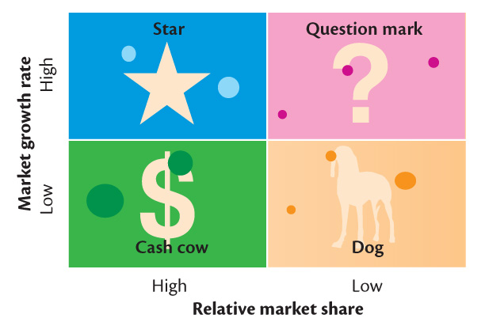

Slide 9
STARS High growth, High market share
Stars are leaders in business.
They also require heavy investment, to maintain its large market share.
It leads to large amount of cash consumption and cash generation.
Attempts should be made to hold the market share otherwise the star will become a CASH COW.

Slide 10
CASH COWS
Low growth , High market share
They are foundation of the company and often the stars of yesterday.
They generate more cash than required.
They extract the profits by investing as little cash as possible
They are located in an industry that is mature, not growing or declining.

Slide 11
DOGS Low growth, Low market share
Dogs are the cash traps.
Dogs do not have potential to bring in much cash.
Number of dogs in the company should be minimized.
Business is situated at a declining stage.

Slide 12
QUESTION MARKS High growth , Low market share
Most businesses start of as question marks.
They will absorb great amounts of cash if the market share remains unchanged, (low).
Why question marks?
Question marks have potential to become star and eventually cash cow but can also become a dog.
Investments should be high for question marks.

Slide 13
WHY BCG MATRIX ?
To assess :
Profiles of products/businesses
The cash demands of products
The development cycles of products
Resource allocation and divestment decisions

Slide 14
MAIN STEPS OF BCG MATRIX
Identifying and dividing a company into SBU.
Assessing and comparing the prospects of each SBU according to two criteria :
1. SBU’S relative market share.
2. Growth rate OF SBU’S industry.
Classifying the SBU’S on the basis of BCG matrix.
Developing strategic objectives for each SBU.

Slide 15
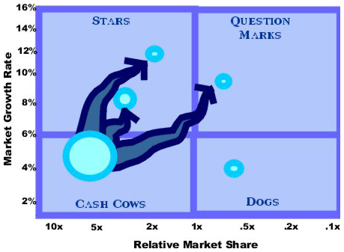
BCG MATRIX WITH CASH FLOW

Slide 16
BENEFITS
BCG MATRIX is simple and easy to understand.
It helps you to quickly and simply screen the opportunities open to you, and helps you think about how you can make the most of them.
It is used to identify how corporate cash resources can best be used to maximize a company’s future growth and profitability.

Slide 17
LIMITATIONS
BCG MATRIX uses only two dimensions, Relative market share and market growth rate.
Problems of getting data on market share and market growth.
High market share does not mean profits all the time.
Business with low market share can be profitable too.

Slide 18
External Analysis: The Identification of Industry Opportunities and Threats

Slide 19
The Environment
Macro-environment
Trends and events that affect all firms (albeit in different ways)
Micro-environment
Trends and events that affect a particular firm or set of firms
Traditional focus on industry analysis
E.g. airline industry, computer industry, banking industry
Issues in determining the boundary of an industry

Slide 20
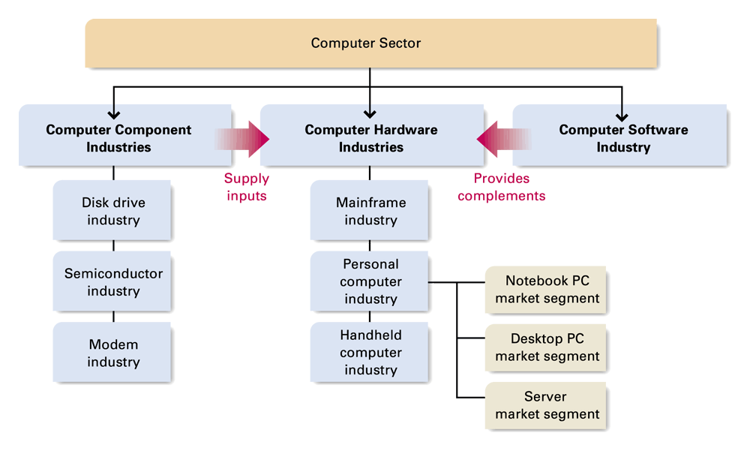
Sectors, industries, segments…

Slide 21
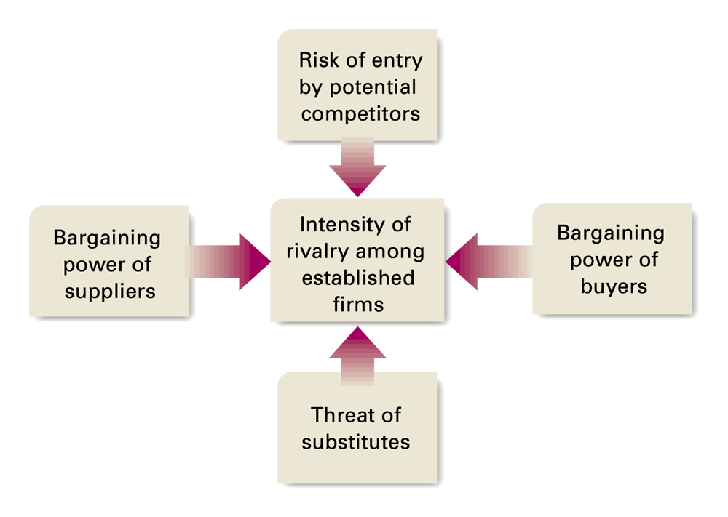
The Five Forces Model

Slide 22
Potential Competitors
New entrants into an industry threaten incumbent companies.
Barriers to entry:
Brand loyalty
Absolute cost advantages
Economies of scale
Switching costs
Government regulation
Entry barriers reduce the threat of new and additional competition.

Slide 23
Rivalry Among Established Companies
The intensity of competitive rivalry in an industry arises from:
Industry’s competitive structure.
Demand (growth or decline) conditions in industry.
Height of industry exit barriers
Investment in specialized assets
High fixed costs of exit
Emotional attachments to an industry

Slide 25
The Bargaining Power of Buyers
Buyers are most powerful when:
There are many small sellers and few large buyers.
Buyers purchase in large quantities.
A single buyer is a large customer to a firm.
Buyers can switch suppliers at low cost.
Buyers purchase from multiple sellers at once.
Buyers can easily vertically integrate to compete with suppliers.

Slide 26
The Bargaining Power of Suppliers
Suppliers have bargaining power when:
Their products have few substitutes and are important to buyers.
The buyer’s industry is not an important customer to the supplier.
Differentiation makes it costly for buyers to switch suppliers.
Suppliers can vertically integrate forward to compete with buyers and buyers can’t integrate backward to supply their own needs.

Slide 28
Substitute Products
The competitive threat of substitute products increases as they come closer to serving similar customer needs.
Far
Close

Slide 30
The implications of five forces model
It makes it possible to diagnose the competitive forces and characterize the position of a company.
To a large extent, the forces influences the rules of the game of the competitors and the strategies which are potentially available.
To an extent, it determines the profit potential of the industry.

Slide 31
A Sixth Force: Complementors
Complementors:
Companies whose products are sold in tandem with another company’s products.
Increased supply of a complementary product collaterally increases demand for the primary product.
Concept of co-opetition
Example:
Faster CPU chips fuel sales of personal computers.

Slide 32
Exercise
In groups of 3-5, perform a five forces model on an industry with which you are familiar
Is it an attractive industry?
Why/why not?

Slide 33
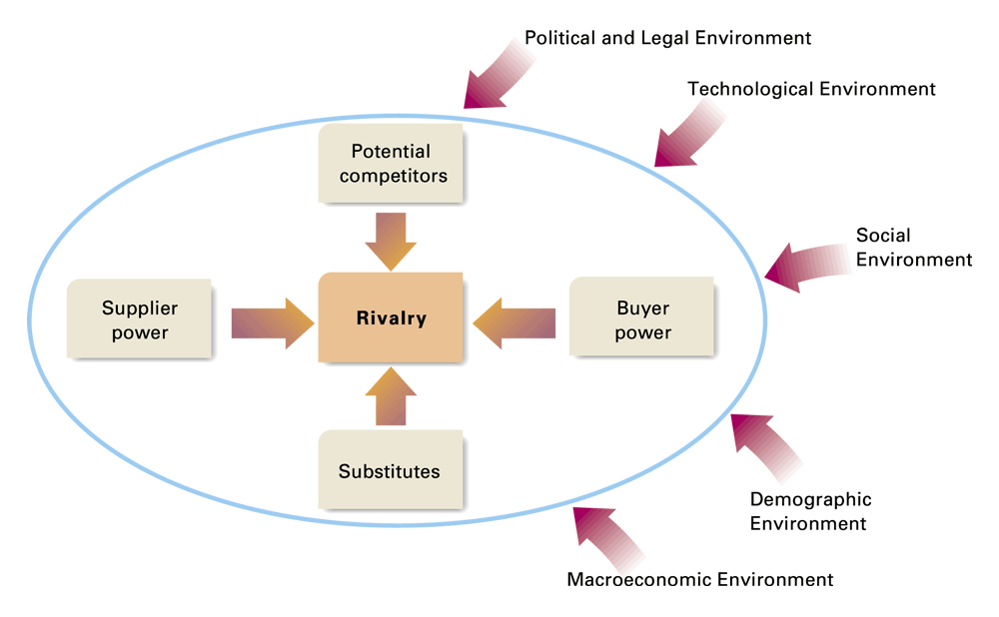
The Role of the Macroenvironment

Slide 34
Macroenvironment
Macroeconomic: e.g. growth rate of the economy, interest rates, currency exchange rates, and inflation rates
Technological: e.g. Internet
Social: Greater health consciousness (e.g. diet)
Demographic: General aging of population in U.S. and some other countries
Political: e.g. change of the administration
Legal: e.g. Anti-Trust

Slide 35
Macro environment factors: PESTLE analysis
Q: What does ‘pestle’ stand for?
POLITICAL
ECONOMICAL
SOCIO-ECONOMICAL
TECHNOLOGICAL
LEGAL
ENVIRONMENTAL

